Slide 1
House Price Prediction
By Surjeet Singh

Slide 2
Problem Statement
Population is increasing
More number of houses are required for living
Correct price placement of house is important
Machine learning model is required to predict the price accurately

Slide 3
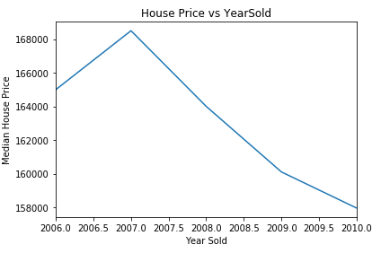
Price with age of house
Strength of material used reduced
Modification and repaired required after certain time
Price of the house decreasing with the age of the house

Slide 4
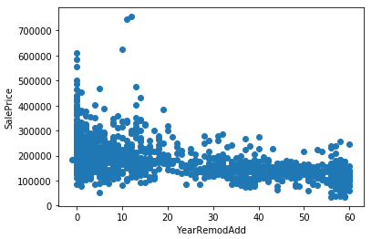
Price with modification year
Price also decreasing as time goes on after remodification
Similar behavior observed in the case of garage build year

Slide 5
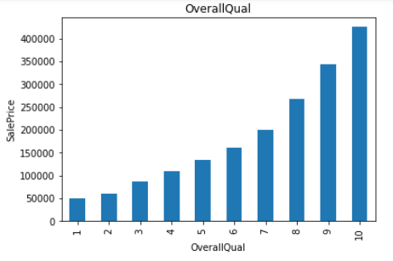
Overall Quality
Overall quality comes out to be the most important feature
Average price increasing exponentially as overall quality increases

Slide 6
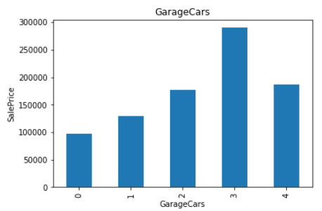
Price vs number of garages
More number of garages, more parking space
The cost increase as the number of garages increase

Slide 7
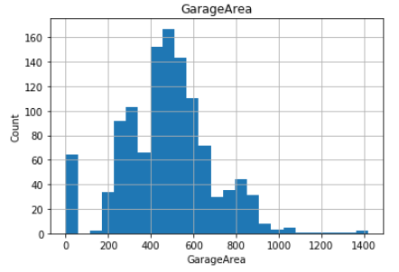
Continuous Variable Distribution
Most of the continuous variables are normally distributed
Continuous variables has skewness in distribution
Skewness removed by using logarithmic transformation

Slide 8
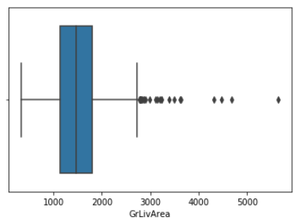
Outlier Analysis
All continuous variables have outliers in it
We have not removed the outliers because we will lose huge amount of data

Slide 9
Missing Values Analysis
There are missing or NaN values in dataset
The variables having 90% missing values has been removed
Missing values replaced by the median for remaining variables

Slide 10
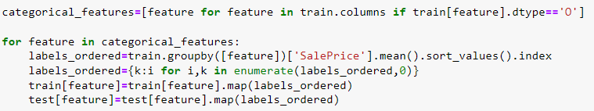
Label Encoding
There are ordinal variables
Machine learning algorithm cannot accept strings
Values in the columns replaced by appropriate numbers

Slide 11
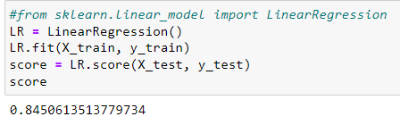

Machine Learning Models
Linear Regression
Linear regression has accuracy of approx. 85%
Fluctuation in accuracy in cross validation

Slide 12
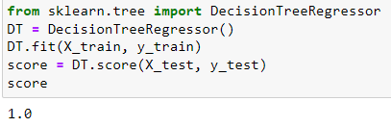

Machine Learning Models
Decision Tree
Decision Tree has accuracy of approx. 100%
Fluctuation in accuracy in cross validation

Slide 13
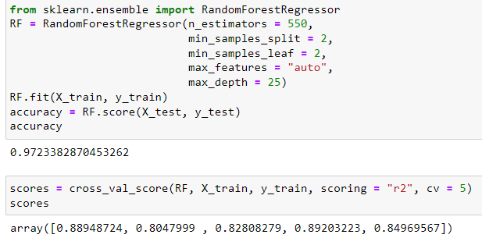
Machine Learning Models
Random Forest
Random Forest has accuracy of approx. 97%
relatively less fluctuation in accuracy in cross validation
Parameters are fine tuned by random search CV

Slide 14
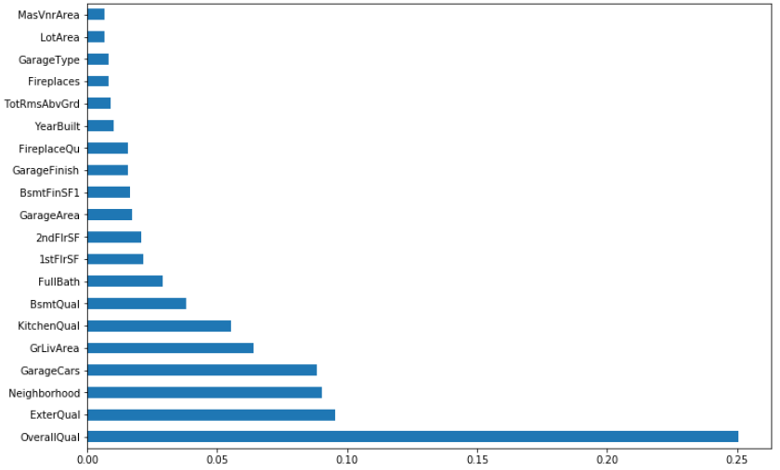
Feature Importance
20 most important variables are plotted
Most important feature comes out to be overall quality of house

